Slide 1
Extraordinary Rhymes
Developed by James Yen

Slide 2
What is Extraordinary Rhymes?
Simple web app for constructing song lyrics
Rhyme suggestion
Highlighting song sections
Syllable counting | Bar lines
Specific emphasis on rap lyrics (hip-hop)
Mobile friendly
Targeted toward both amateur and professional songwriters
Just a tool

Slide 3
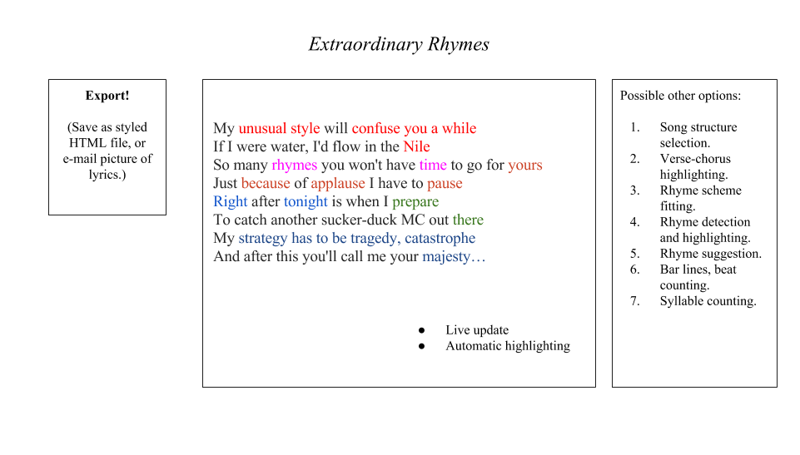

Slide 4
How is it made?
Predominantly client-side web technology
HTML, CSS, JavaScript
jQuery
Bootstrap
Ajax calls to various APIs (Datamuse API, completely free with no API key required)
Hosting is ephemeral
Node.js, Apache, nginx, it’s up to you
Tools
Sublime Text 3, Notepad++
GitHub Desktop
Vim
Git
Google Chrome, Iceweasel

Slide 5
Preliminary development schedule
Next 2 weeks: completion of rhyme detection and highlighting, live, while typing, using Datamuse API
After next 2 weeks: ???
Still deciding which features to implement and how exactly it’s going to be done
Possible obstacles:
APIs do not detect all rhymes:
Island
Violin
Styling
Force rhyme consideration?
Decisions:
Detect song structure and rhyme scheme a posteriori, and name it? (After the fact.)
Format song structure by creating a structure and then shoehorn it or force it.

Slide 6
Questions, comments, clarifications?
Yes Flanders, the world IS ending.

